Slide 1
SALES DATA
Name:A.Shivani Reddy
Roll No:2211CS010003(S2)
Dataset:Sales Data
Email:appidishivanireddy7173@gmail.com
LinkedIn:www.linkedin.com/inshivani-reddy-11b548331

Slide 2
Introduction:
This project analyzes 2017 sales data to understand patterns in orders, product performance, customer behavior, and sales territories.
It aims to identify key trends, high-performing products, and customer insights for business improvement.Tools used: Python, Pandas, Matplotlib, Seaborn for visualization and analysis.

Slide 3
Tools used:
Python, Pandas, Matplotlib, Seaborn for visualization and analysis.
Initial Analysis of the Dataset:
The dataset contains columns such as OrderDate, ProductKey, CustomerKey, TerritoryKey, and OrderQuantity.

Slide 4
Initial cleaning steps included:
Converting OrderDate to datetime format.
Handling null or missing values.
Aggregating orders by product, customer, and territory.
The data provides a solid foundation for analyzing sales distribution, product demand, and regional performance.

Slide 5
Dataset Overview:
The dataset records individual sales transactions across multiple products and territories during 2017.
Each record represents the quantity ordered of a product by a specific customer in a defined region.

Slide 6
Key attributes analyzed:
OrderQuantity – total units sold per order.
ProductKey – identifies the product.
CustomerKey – unique identifier for each customer.
TerritoryKey – represents the sales region.
OrderDate – the date when each order was placed.

Slide 7
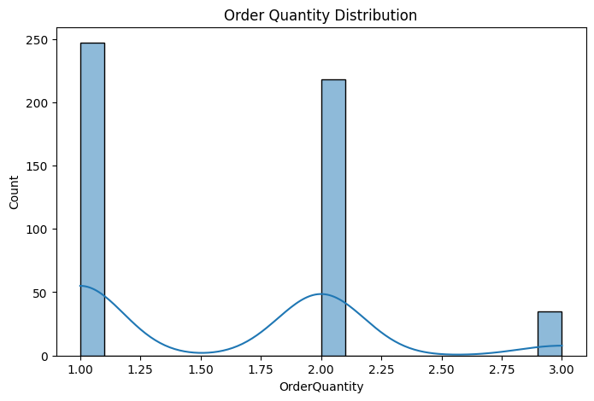
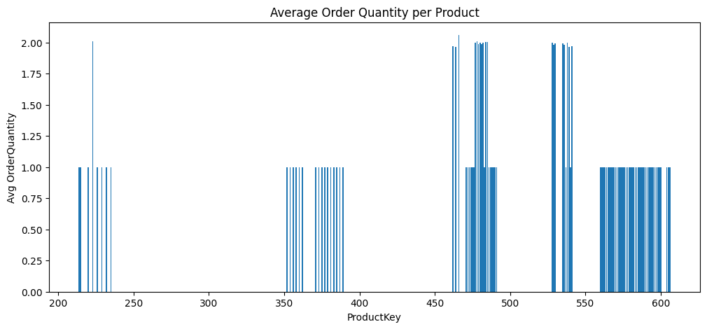
GRAPHS:
Graph 1 –
Order Quantity DistributionType: Histogram with KDE
Most orders have small quantities, showing frequent low-volume sales.
Few large orders contribute heavily to overall quantity.
The distribution is right-skewed, indicating rare bulk purchases.
Graph 2 –
Average Order Quantity per ProductType: Bar GraphSome products show a much higher average order quantity.
Indicates strong market demand for a few key products.
Low-performing products may need improved promotion or pricing.

Slide 8
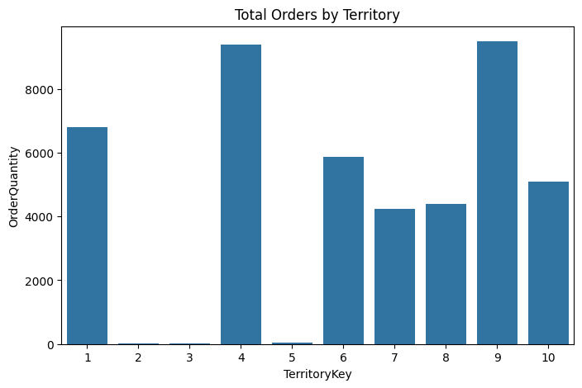
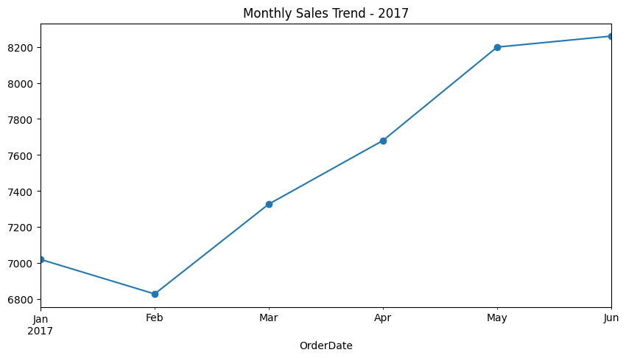
Graph 3 –
Total Orders by TerritoryType: Bar ChartCertain territories record significantly higher total sales.
Suggests regional dominance and concentration of customer activity.
Underperforming areas may need better marketing or logistics.
Graph 4 –
Monthly Sales Trend (2017)Type: Line ChartSales fluctuate across months, showing seasonal variations.
Noticeable peaks in specific months indicate demand surges.
Helps in planning promotions and inventory for high-sales periods.

Slide 9
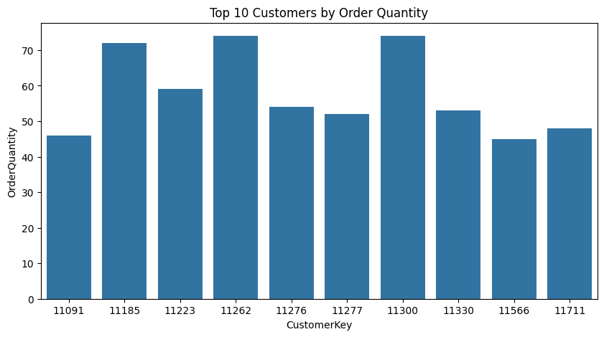
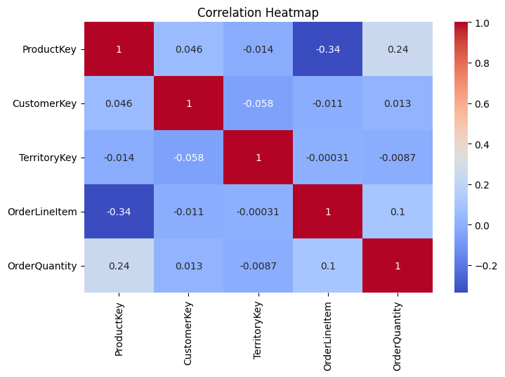
Graph 5 –
Top 10 Customers by Order QuantityType: Bar ChartA small set of customers contributes to a large share of orders.
Reflects strong loyalty among top buyers.
These key customers are vital for sustaining total revenue.
Graph 6 –
Correlation HeatmapType: HeatmapShows relationships between numeric features in the dataset.
Strong correlations help identify sales-driving variables.
Useful for selecting features for predictive or regression models.

Slide 10
Conclusion:
The analysis highlights that a few products and regions dominate total sales.Small but frequent orders are common, complemented by occasional bulk purchases.
Top customers drive major revenue, emphasizing the need for customer-focused retention efforts.
Seasonal trends can guide marketing campaigns and stock management.
The dataset provides strong potential for predictive modeling in sales forecasting and product demand estimation.

